Slide 1
PROJECT TITLE
MICRO CREDIT DEFAULTER
BY – KHUSHBOO GUPTA

Slide 2
Problem Statement
A Microfinance Institution (MFI) is an organization that offers financial services to low income populations. MFS becomes very useful when targeting especially the unbanked poor families living in remote areas with not much sources of income. The Microfinance services (MFS) provided by MFI are Group Loans, Agricultural Loans, Individual Business Loans and so on.
Many microfinance institutions (MFI), experts and donors are supporting the idea of using mobile financial services (MFS) which they feel are more convenient and efficient, and cost saving, than the traditional high-touch model used since long for the purpose of delivering microfinance services. Though, the MFI industry is primarily focusing on low income families and are very useful in such areas, the implementation of MFS has been uneven with both significant challenges and successes.
Today, microfinance is widely accepted as a poverty-reduction tool, representing $70 billion in outstanding loans and a global outreach of 200 million clients.
We are working with one such client that is in Telecom Industry. They are a fixed wireless telecommunications network provider. They have launched various products and have developed its business and organization based on the budget operator model, offering better products at Lower Prices to all value conscious customers through a strategy of disruptive innovation that focuses on the subscriber.
They understand the importance of communication and how it affects a person’s life, thus, focusing on providing their services and products to low income families and poor customers that can help them in the need of hour.
They are collaborating with an MFI to provide micro-credit on mobile balances to be paid back in 5 days. The Consumer is believed to be defaulter if he deviates from the path of paying back the loaned amount within the time duration of 5 days. For the loan amount of 5 (in Indonesian Rupiah), payback amount should be 6 (in Indonesian Rupiah), while, for the loan amount of 10 (in Indonesian Rupiah), the payback amount should be 12 (in Indonesian Rupiah).
The sample data is provided to us from our client database. It is hereby given to you for this exercise. In order to improve the selection of customers for the credit, the client wants some predictions that could help them in further investment and improvement in selection of customers.

Slide 3
Our Exercise
Build a model which can be used to predict in terms of a probability for each loan transaction, whether the customer will be paying back the loaned amount within 5 days of insurance of loan. In this case, Label ‘1’ indicates that the loan has been payed i.e. Non- defaulter, while, Label ‘0’ indicates that the loan has not been payed i.e. defaulter.

Slide 4
Points to Remember
There are no null values in the dataset.
There may be some customers with no loan history.
The dataset is imbalanced. Label ‘1’ has approximately 87.5% records, while, label ‘0’ has approximately 12.5% records.
For some features, there may be values which might not be realistic. You may have to observe them and treat them with a suitable explanation.
You might come across outliers in some features which you need to handle as per your understanding. Keep in mind that data is expensive and we cannot lose more than 7-8% of the data.

Slide 5
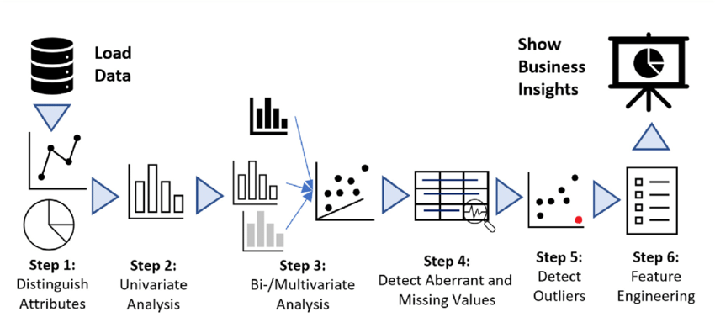
Exploratory Data Analysis

Slide 6
Steps Involved
Load the dataset
Distinguish the attributes
Checking the null values & handled them accordingly
Do the EDA
Check the correlation & removing the outliers
Feature Engineering – Find the best machine learning model to get the best accuracy.
Check the cross val score & perform the hypermeter tuning.
Save the model & check the predicted & actual values using the best saved model.

Slide 7
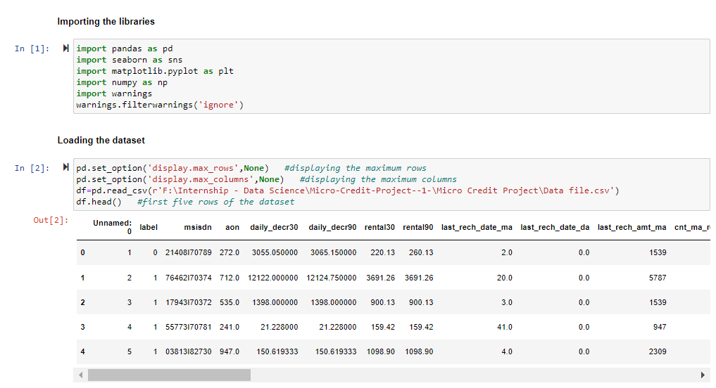
Load the dataset

Slide 8
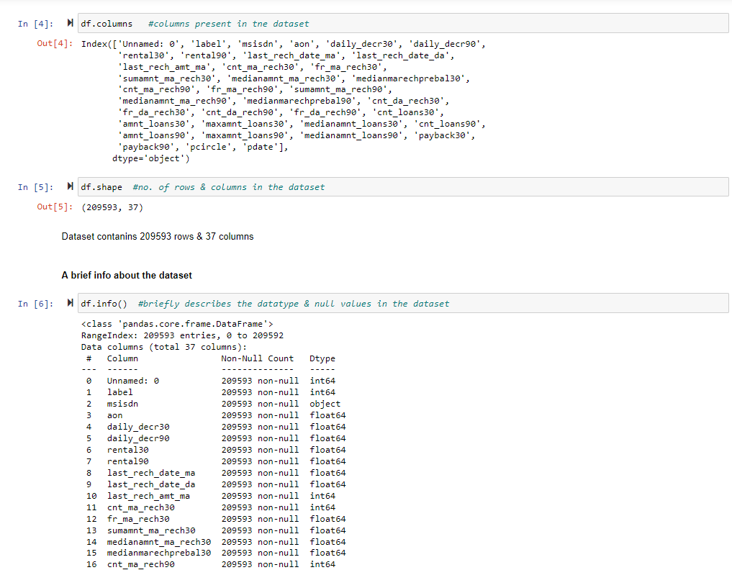
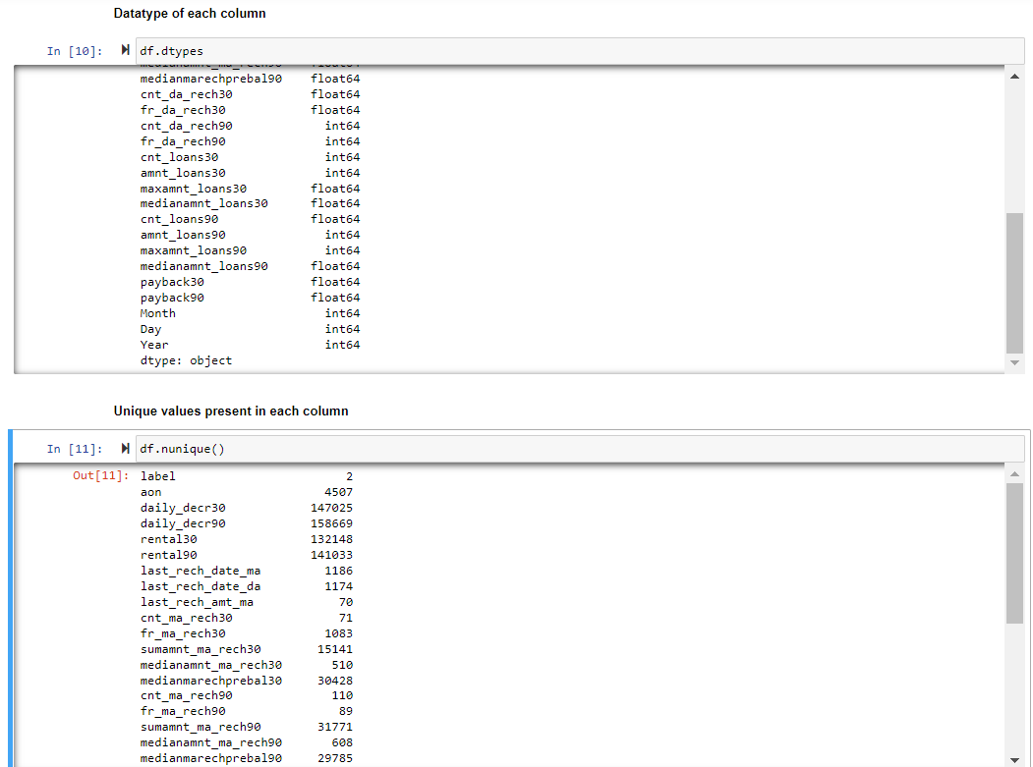
Checking the Attributes
First & last five rows the dataset
Shape of the dataset
Columns present in the dataset
Brief info about the dataset
Datatype of each column
Null values present in the dataset
Number of unique values present in each column

Slide 9
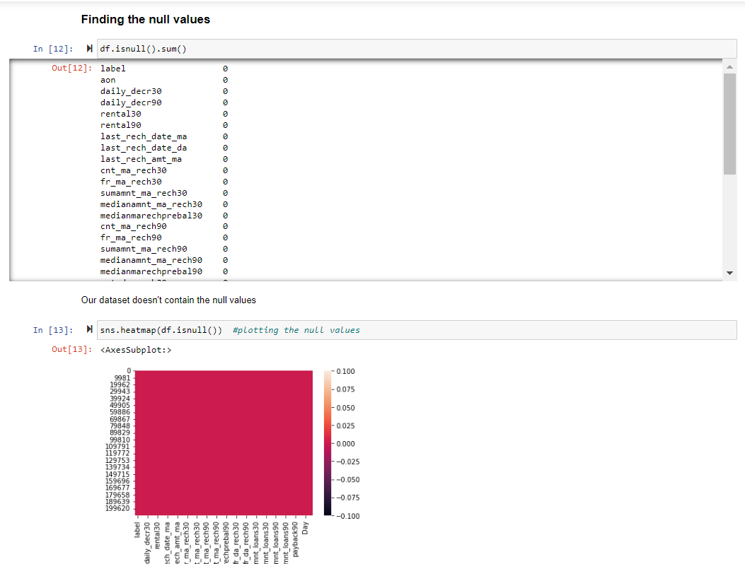
Null Values
As the dataset doesn’t contain the null values so there is no need of null values handling and we can proceed further.

Slide 10
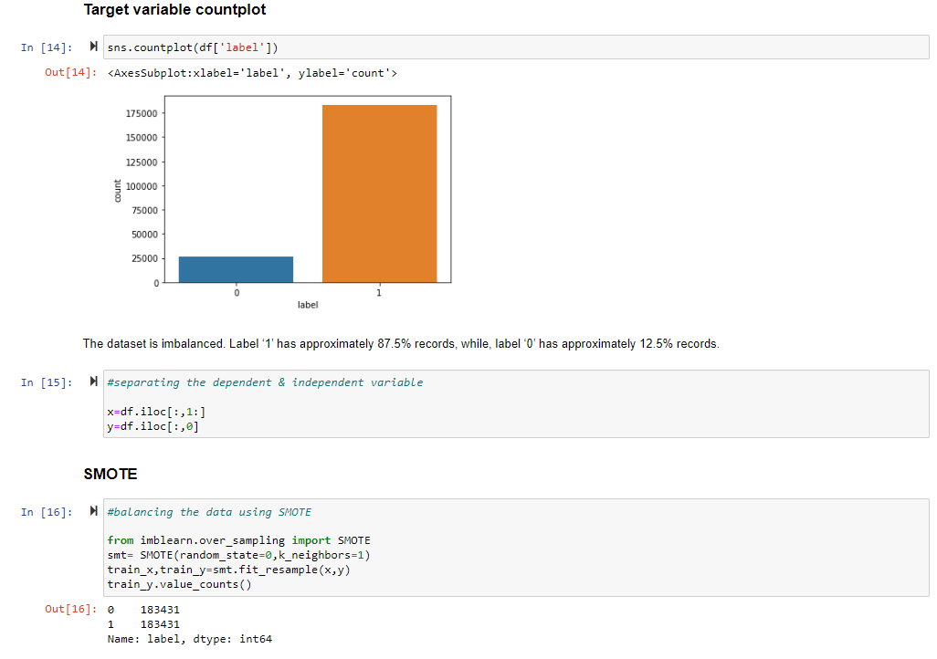
SMOTE
As we see that the dataset is imbalanced. In target variable column, Label ‘1’ has approximately 87.5% records, while, label ‘0’ has approximately 12.5% records. We need to balance the dataset to have better predictions. So, for the same we will use SMOTE which balances the dataset by oversampling & we are going to have equal number for both the labels.

Slide 11
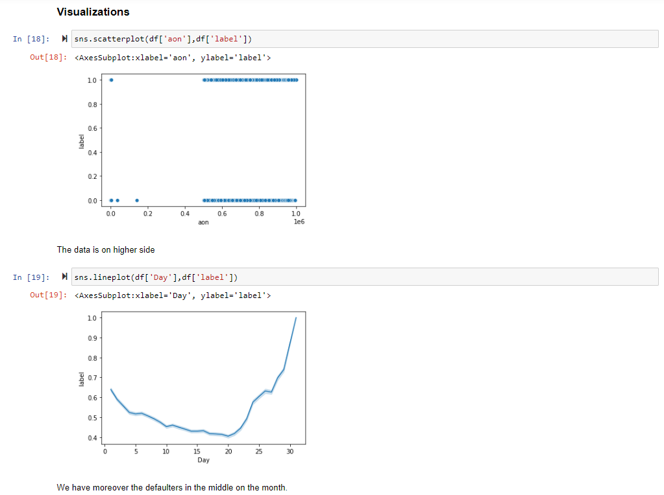
EDA
By using the different plots we try to visualize the each column with the target column.

Slide 12
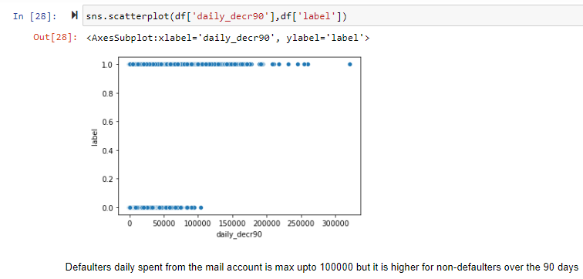
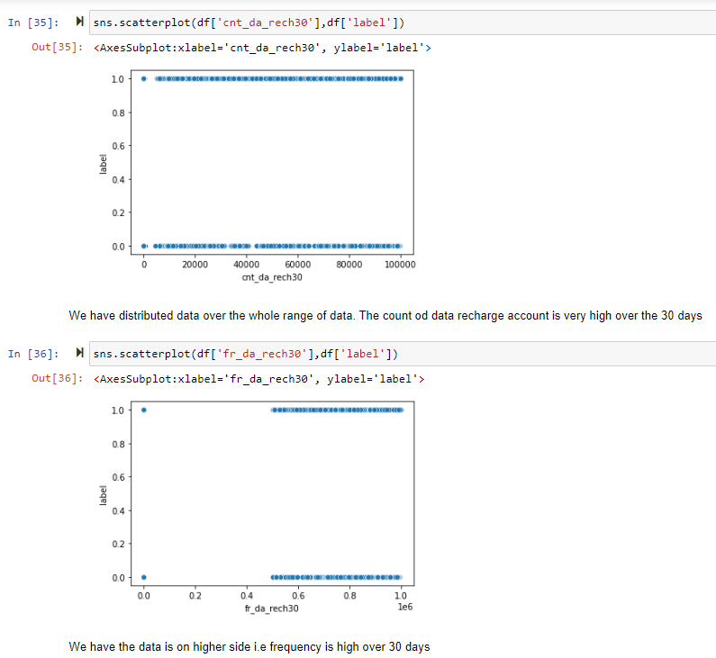
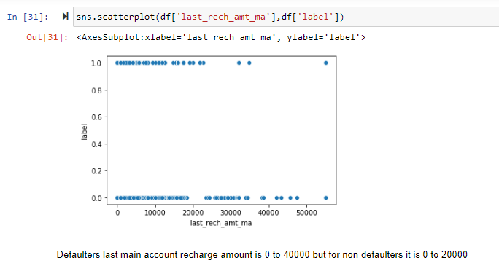

Slide 13
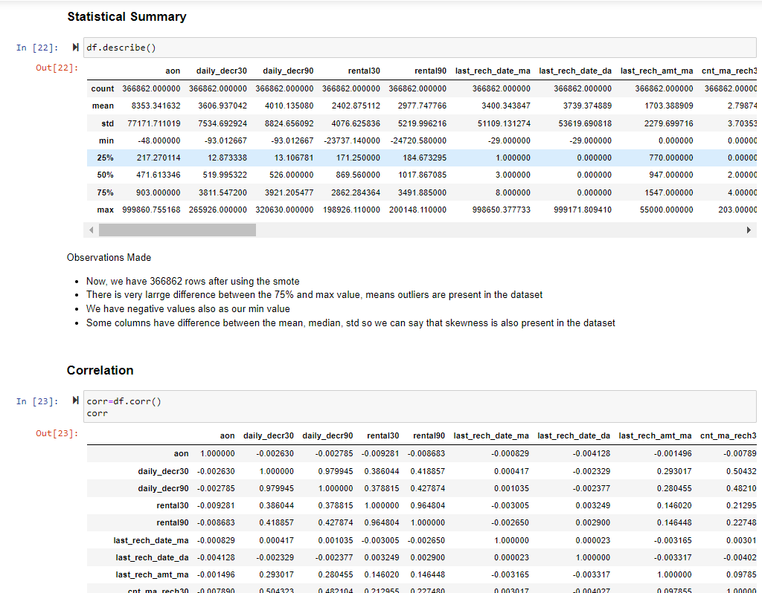
After Doing the EDA, let’s do the next step
Afterwards, using the describe function we will elaborate the statistical summary of the dataset which contains the count, min, max, standard deviation, mean etc. of every column.
Find the correlation between each column
Plotting the outliers using boxplot
Checking the skewness.
Removing the skewness using power transform
Removing the outliers.

Slide 14
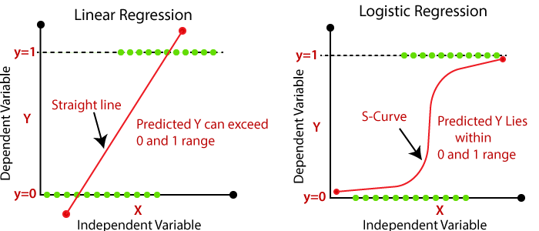
Is this a Regression problem or Classification problem?
By looking at the output i.e. ‘Label’, this is a binary output either 1 or 0 not a continuous output so we go for the classification machine learning algorithms to predict the defaulter.
What does Classification mean?
Classification is the process of finding or discovering a model or function which helps in separating the data into multiple categorical classes i.e. discrete values. In classification, data is categorized under different labels according to some parameters given in input and then the labels are predicted for the data.

Slide 15
Used Classification Algorithms
Logistic Regression
from sklearn.linear_model import LogisticRegression
Decision Tree Classifier
from sklearn.tree import DecisionTreeClassifier
Kneighbor Classifier
from sklearn.neighbors import KNeighborsClassifier
Random Forest Classifier
from sklearn.ensemble import RandomForestClassifier
Gaussian NB
from sklearn.naive_bayes import GaussianNB
SGD Classifier
from sklearn.linear_model import SGDClassifier
MODEL | ACCURACY
Logistic Regression | 0.8794013804510321
Decision Tree Classifier | 0.886876172906263
Random Forest Classifier | 0.9220872165145202
Kneighbor Classifier | 0.8904545309965329
Gaussian NB | 0.5920671777092147
SGD Classifier | 0.8763160405865327

Slide 16
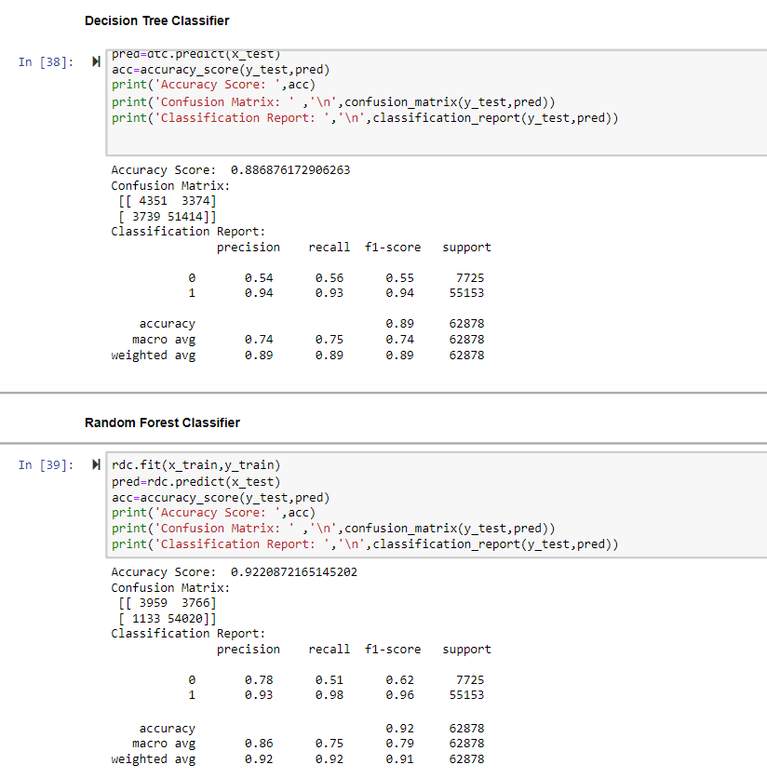
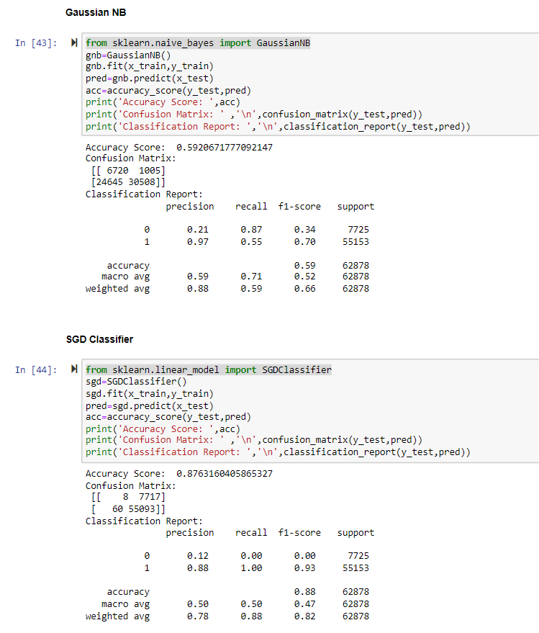

Slide 17
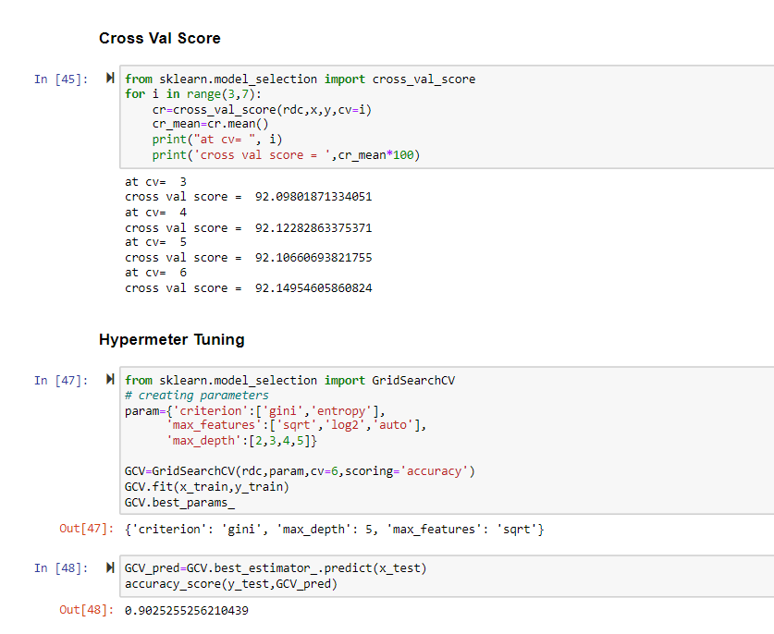
Cross Val Score & Hypermeter Tuning
Finding the cv at which the model runs the best.
Finding the parameters of the model whose accuracy we found the best at which it runs the best using the hypermeter tuning.

Slide 18
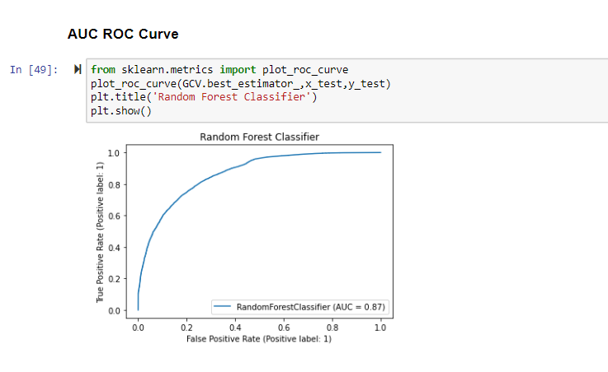
AUC-ROC Curve
What is AUC-ROC Curve?
The Receiver Operator Characteristic (ROC) curve is an evaluation metric for binary classification problems. It is a probability curve that plots the TPR against FPR at various threshold values and essentially separates the ‘signal’ from the ‘noise’. The Area Under the Curve (AUC) is the measure of the ability of a classifier to distinguish between classes and is used as a summary of the ROC curve.
The higher the AUC, the better the performance of the model at distinguishing between the positive and negative classes.
In our model AUC>0.5, so there is a high chance that the classifier will be able to distinguish the positive class values from the negative class values.

Slide 19
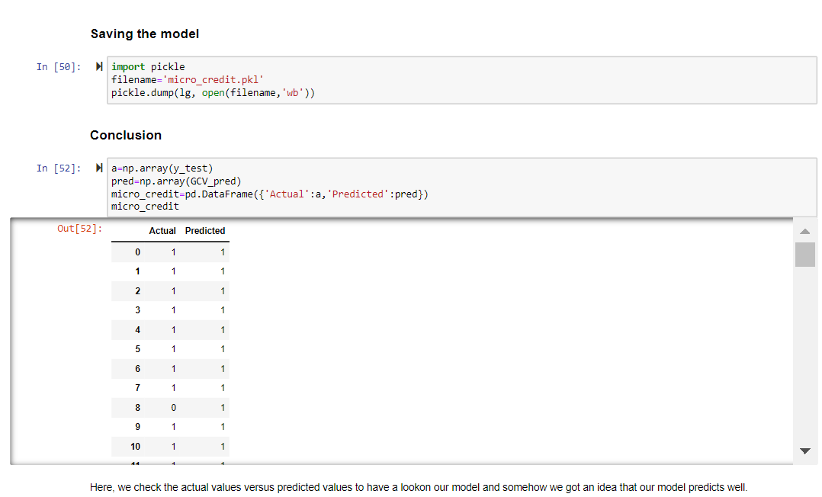
Saving the Model
After doing all the EDA process and find our best regression algorithm we will save that model for future predictions using the pickle algorithm.
We will conclude after comparing the actual & predicted values.

Slide 20


